Slide 1
Lecture:5 The Accounting cycle: Report Financial statement

Slide 2
AFTER STUDYING THIS CHAPTER, YOU SHOULD BE ABLE TO:
Prepare an income statement, a statement of retained earnings, and a balance sheet.
Explain how the income statement and the statement of retained earnings relate to the balance sheet.
Explain the concept of adequate disclosure.
Explain the purposes of closing entries; prepare these entries.
Prepare an after-closing trial balance. Use financial statement information to evaluate profitability and liquidity.
Explain how interim financial statements are
prepared in a business that closes its
accounts only at year-end.
Prepare a worksheet and explain its uses.

Slide 3
presenting the company’s adjusted trial balance at year-end.

Slide 4
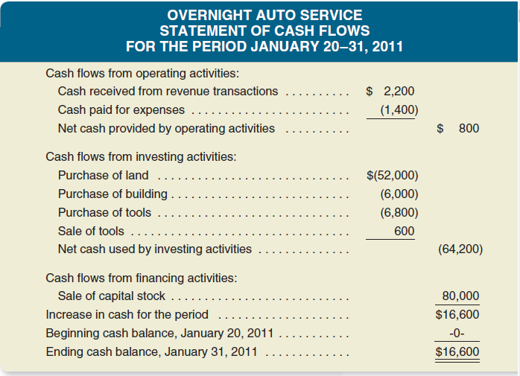
Demonstration

Slide 5
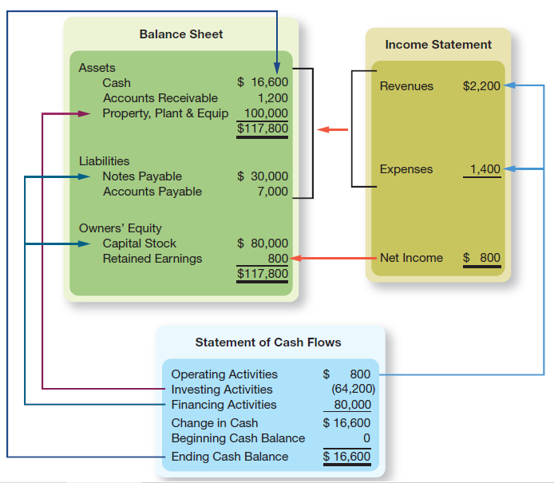
FINANCIAL STATEMENT ARTICULATION

Slide 6
Class Practice

Slide 7
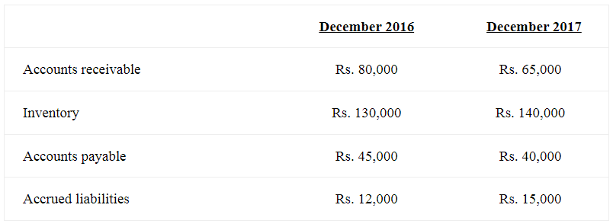
Problem 1
Abdullah sons Company’s current asset and liability balances for the past two years are as follows. Net income for the year was Rs. 120,000 and depreciation expense was Rs. 15,000.
Required: You are require to prepare operating activities. .section of cash flow statement?

Slide 8
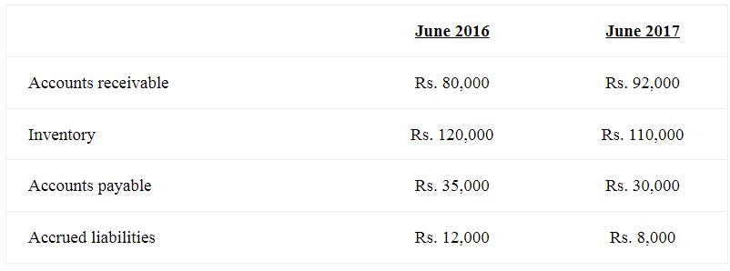
Problem 2
Moons Corporation’s current asset and liability balances for the past two years are as follows. Net income for the year was Rs. 150,000, depreciation expense was Rs. 22,000, and gain on sale of land was Rs. 28,000.

Slide 9
Problem 3
Usama Ali Khan Company experienced the following at end of year, December 2017:
Issued preferred stock for Rs. 250,000
Repurchased Rs. 140,000 of its own common stock
Borrowed Rs. 200,000 from a bank issuing a 5 year note
Retired bonds by paying Rs. 55,000
Declared dividends of Rs. 135,000 payable on March 1, 2018
Required: Prepare the financing section of the statement of cash flows.

Slide 10
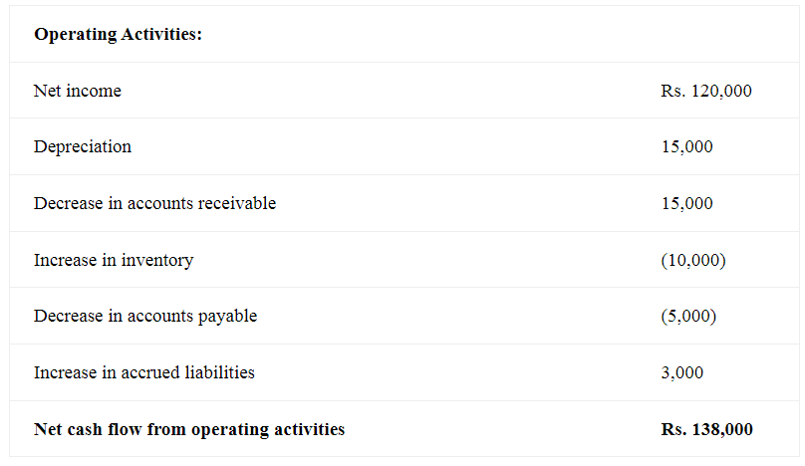
Solution P:1

Slide 11
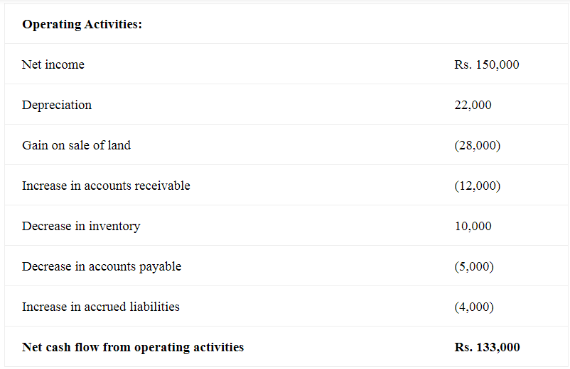
Solution P:2

Slide 12
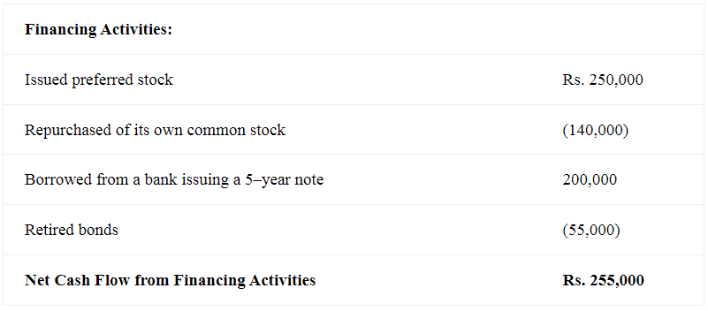
Solution P:3

